Slide 1
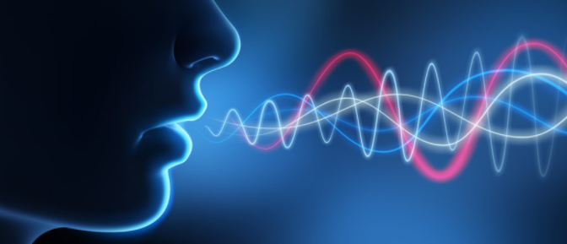
Spoken Language Identification
180020002 180030001 180030037

Slide 2
Introduction and Motivation
Language Identification (LID) systems are used to classify the spoken language from a given audio sample and are typically the first step for many spoken language processing tasks, such as Automatic Speech Recognition (ASR) systems.
Without automatic language detection, speech utterances cannot be parsed correctly and grammar rules cannot be applied, causing subsequent speech recognition steps to fail.
Current ASR systems require users to manually specify the system’s correct input language to work properly.

Slide 3
Current Applications and Future Improvements
Interactive Systems for people with disabilities
Virtual Assistant
Speech Translation Systems
Multilingual Speech Recognition
Speaker Diarization
Autonomous Driver Assistance Systems (A-DAS)

Slide 4
Review of Literature
[2011.12998] VoxLingua107: a Dataset for Spoken Language Recognition
(Dataset)
For the past 20 years, development of SLR technology has been largely fostered through NIST Language Recognition Evaluations(LREs).The datasets corresponding to this costs around 15400 dollars.
This paper focuses on the approach of scraping data from YouTube via phrases obtained from Wikipedia. Finally computing the performance using 'EER' as metric for different architectures.
And finally concluding that the dataset is suitable for training spoken language recognition models for classifying data from the public domain.

Slide 5
Reference
Language Identification Using Deep Convolutional Recurrent Neural Networks
[1910.04269] Spoken Language Identification using ConvNets
Automatic Language Identification Using Speech Rhythm Features for Multilingual Speech Recognition
Dataset
https://lionbridge.ai/datasets/best-speech-recognition-datasets-for-machine-learning/

Slide 6
Concepts Involved
Convolutional Neural Network(CNN)
Recurrent Neural Network(RNN)
A hybrid combination of the above two(CRNN)
Long-Short Term Memory (LSTM)
Sequence-to-Sequence Models (Seq2Seq)
Study of existing standard architectures used in production
Mel Frequency Cepstral Coefficients (MFCC) and Feature Modeling

Slide 7
Structure of the Plan
1) Exploring Datasets to work upon.
2) Extraction of features which are relevant to purpose. (Prominently, MFCC features)
3) Building a base model and evaluating the performance using relevant metrics.
4) Tweaking some feature properties, model parameters and trying out different architectures to improve the performance.
5) Tuning the hyperparameters to further improve performance.
5) Suggestions to deploy the architecture in the real world.

Slide 8
Timeline
Machine Learning Approaches (GMM and GMM-HMM) (Phase-1)
CNN and RNN based Approaches (Phase-2)
LSTM and CNN-RNN combined Approaches (Phase-3)
Seq2Seq (Encoder-Decoder) Model Approaches (Phase-4)
Finally Comparison of all approaches and taking inferences about the optimal model (Phase-5)

Slide 9


Slide 10
Performance Metrics for Comparison
Confusion Matrix and related parameters

Slide 11
Team Structure
Team Members:
Amitabh Swain : 180020002
Rushikesh Dixit : 180030037
Abhay Baghel : 180030001
Mentor
Soma Siddhartha

Slide 12
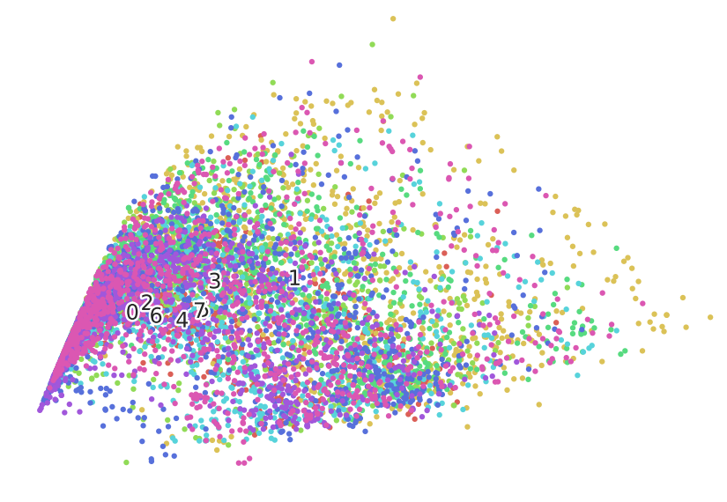
Dataset Diversity : PCA Analysis
Original Encoding
* 1 - Bengali (bn)
* 2 - English (en)
* 3 - Gujarati (gu)
* 4 - Hindi (hi)
* 5 - Kannada (kn)
* 6 - Malayalam (ml)
* 7 - Nepali (ne)
* 8 - Tamil (ta)

Slide 13
Previous Model (Last Phase)
Previous Model : 4-layered Dense Neural Network Model
(Feed Forward Network)
Dataset : VoxLingua107
Languages Selected : English, Hindi and Tamil
Max Duration = 14s
Min Duration = 4s
Average Duration = 7s
Features Used : 13 MFCCs (framewise)
Training Accuracy = 95.42 %
Test Accuracy = 62.67 %

Slide 14
Previous Model (Current Phase)
Previous Model : 4-layered Dense Neural Network Model
(Feed Forward Network)
Dataset : VoxLingua107
Languages Selected : English, Hindi, Tamil, Bengali,Nepali,Malayalam,Kannada and Gujarati.
Max Duration = 14s
Min Duration = 4s
Average Duration = 7s
Features Used : 13 MFCCs + 13 delta + 13 delta-delta coefficients(framewise)
Training Accuracy = 94.98 %
Test Accuracy = 31.75 %

Slide 15
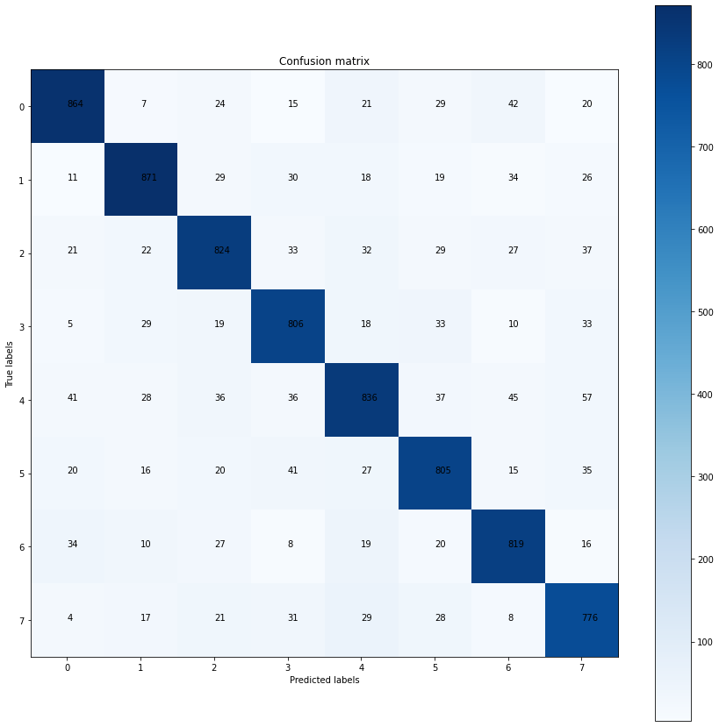
Feed Forward Model : Results

Slide 16
Current Model
Model : Convolutional Neural Network Model
Dataset : Vox Lingua 107
Languages Selected : English, Hindi, Tamil, Bengali,Nepali,Malayalam,Kannada and Gujarati.
Max Duration = 14s
Min Duration = 4s
Average Duration = 7s
Features Used : 13 MFCCs + 13 delta + 13 delta-delta coefficients(framewise)
Training Accuracy = 89.41 %
Test Accuracy = 69.94 %

Slide 17
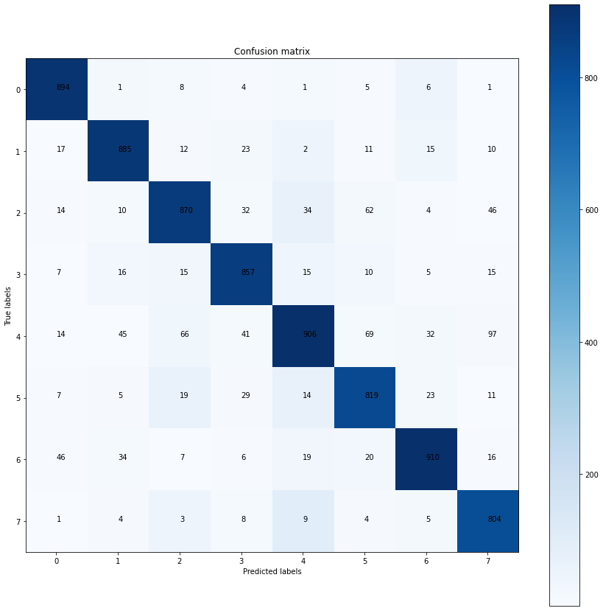
CNN Model : Results

Slide 18
Last Model
Model : LSTM
Dataset : Vox Lingua 107
Languages Selected : English, Hindi, Tamil, Bengali,Nepali,Malayalam,Kannada and Gujarati.
Max Duration = 14s
Min Duration = 4s
Average Duration = 7s
Features Used : 13 MFCCs + 13 delta + 13 delta-delta coefficients(framewise)
Training Accuracy = 89.51 %
Test Accuracy = 14.69 %

Slide 19
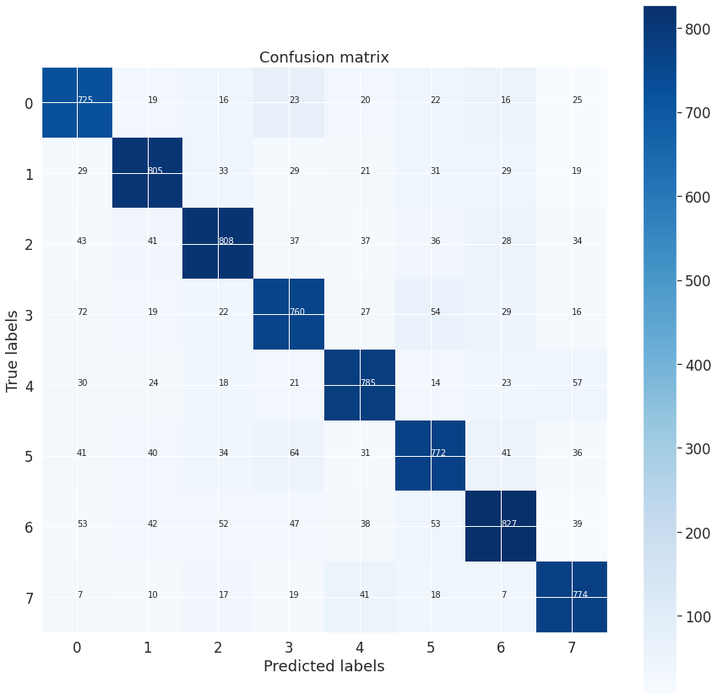
LSTM Model : Results

